Slide 1

Targil 1
Challenges in vision science
Shahar shamur
Submission date: 25.04.2025

Slide 2
description of the task
In the Cambridge Face Memory Test, I was asked to memorize a set of unfamiliar faces. After that, I had to recognize these faces among other similar-looking faces, sometimes shown from different angles or in different lighting. The test was designed to measure how well I can remember and recognize faces. It’s often used in research to study face recognition skills and conditions like face blindness.

Slide 3

Calculation of the visual angle
Stimulus size – 4.5 cm.
Distance – 60 cm.
According to the equation → $2∙arctan⁡( \frac{h}{2d} )$= θ
So the visual angle → $2∙arctan⁡(\frac{4.5}{2∙60})$ → $2∙2.14758$ = 4.29 degrees.

Slide 4
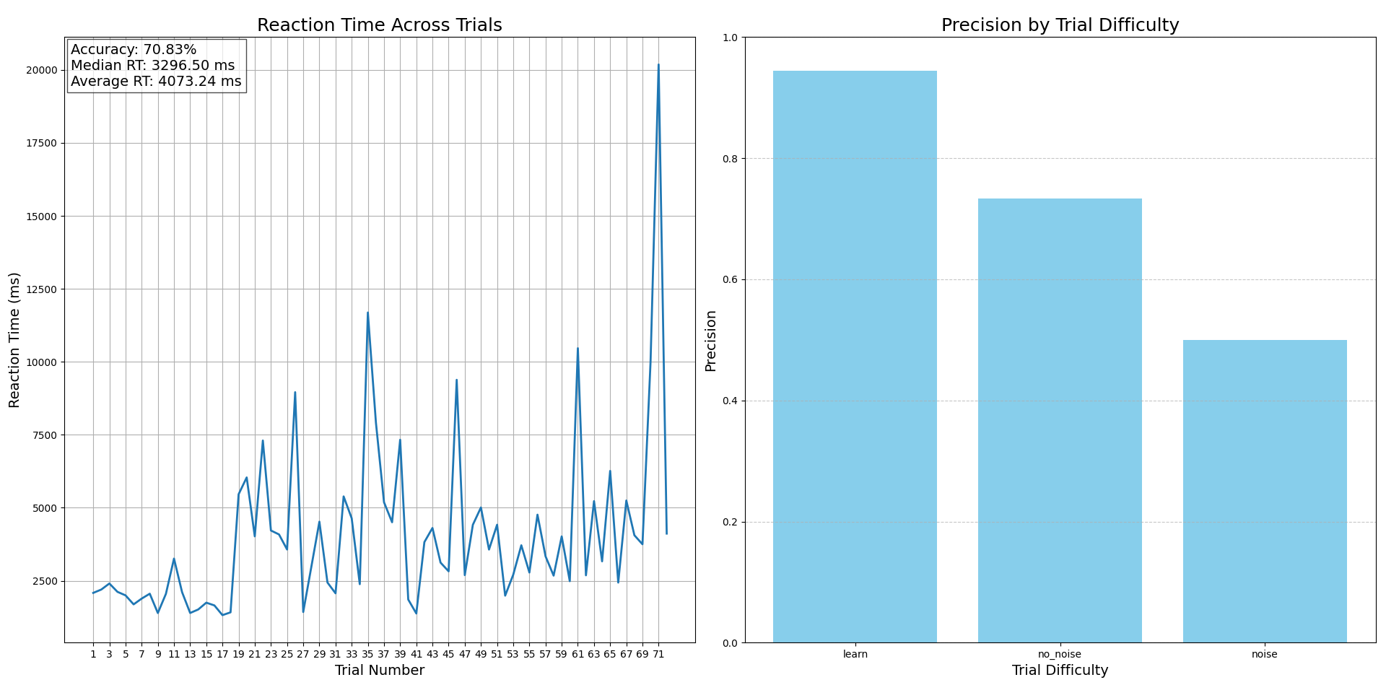
shahar

Slide 5
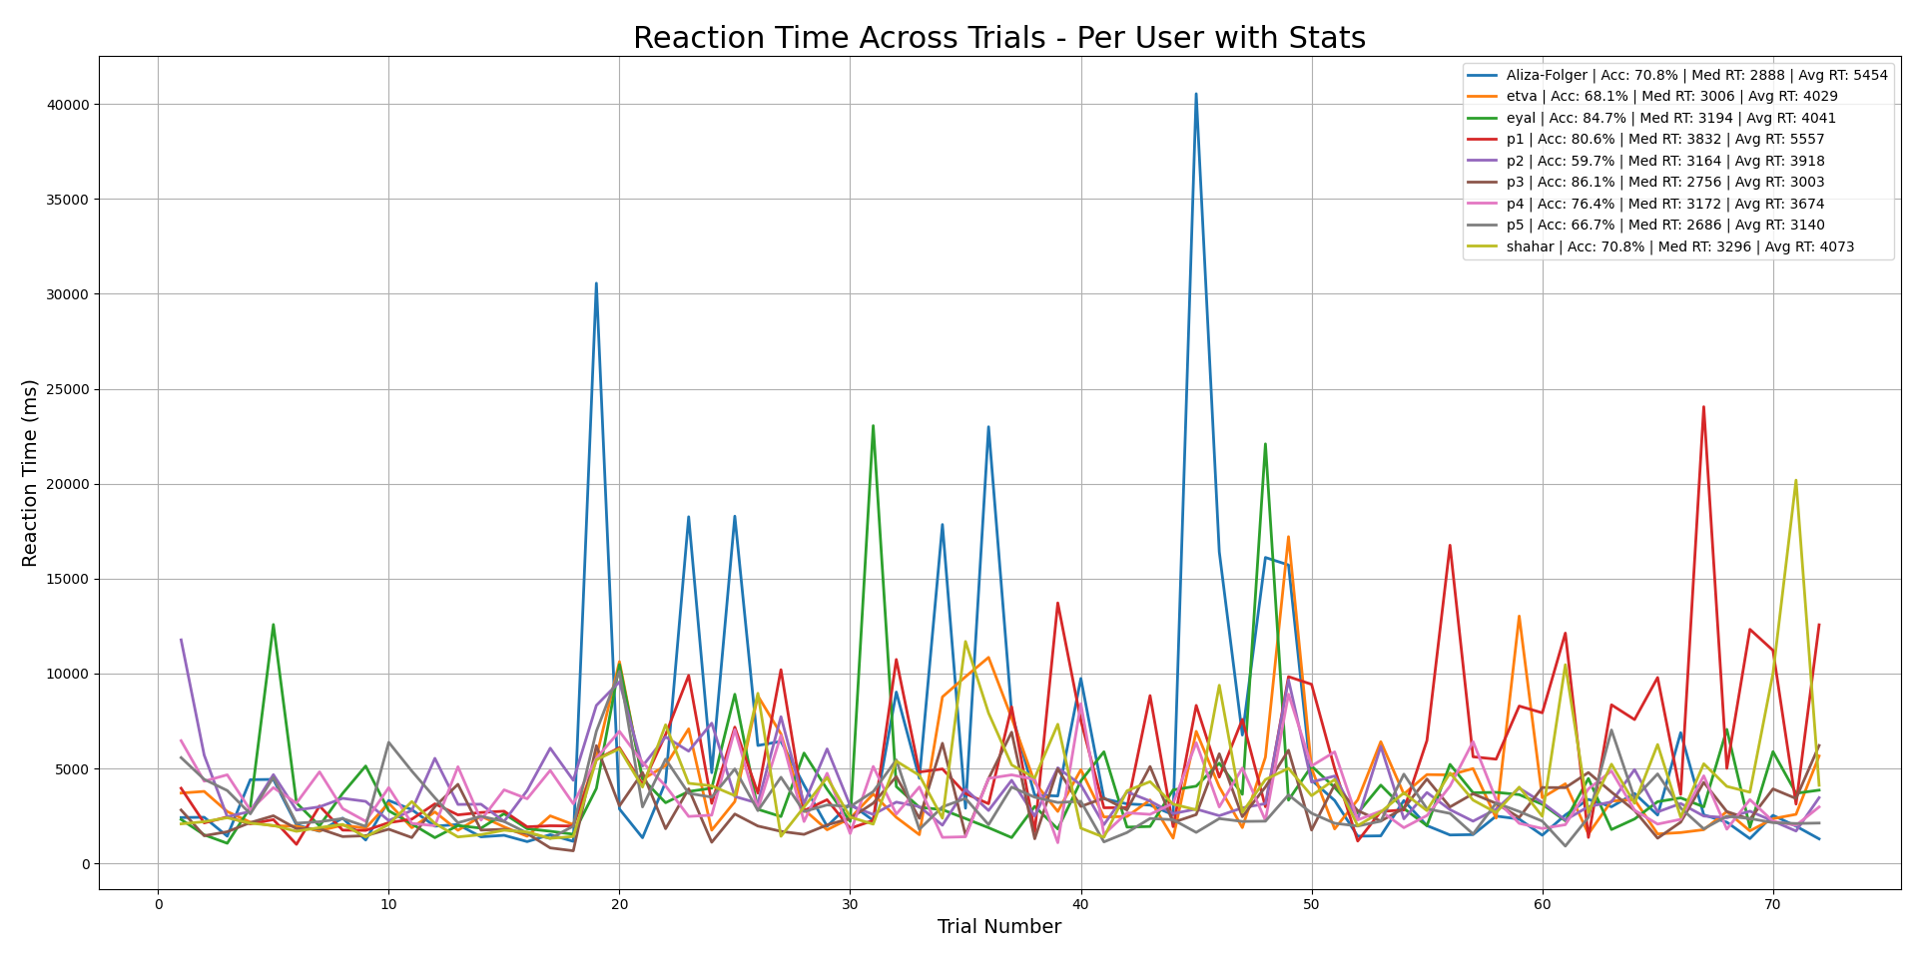
Group analyzing

Slide 6
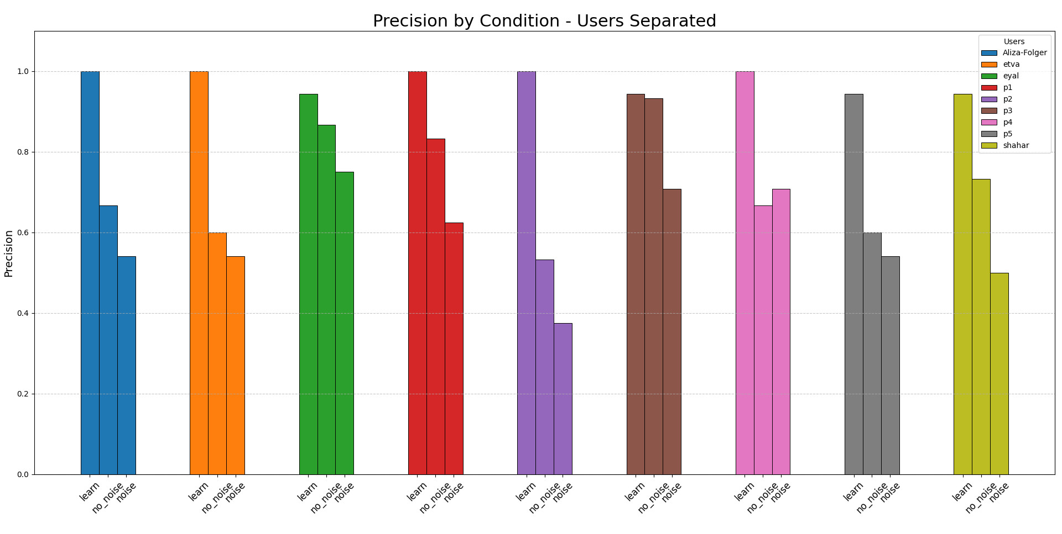
Group analyzing

Slide 7
To built this graphs I used python in vs code: the code is available here:
https://github.com/shahar9991/t1_vision.git

